Slide 1
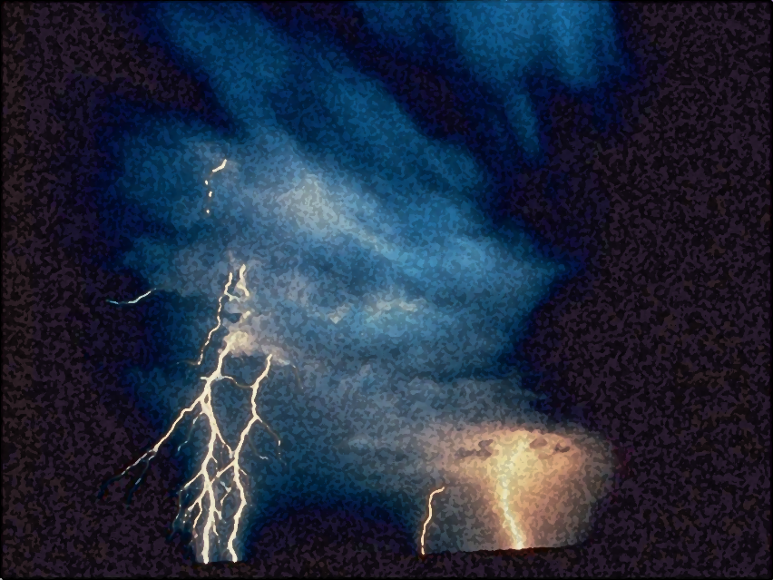

A Light out of Darkness
The Vision of Isaiah
Doom to Bloom

Slide 2


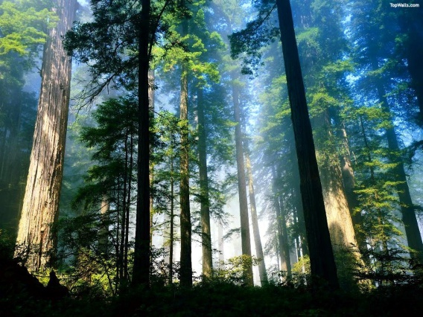
Will You Believe?
Two Great Forests
Israel and Assyria
In Whom will Man Trust?
God or Nations
Notes:
Because of pride and arrogance, false leadership, dissension amongst the brethren, and oppression, especially against the poor and weak God has decreed destruction on Israel and the nations. Israel had rebelled and abandon the LORD, the Holy One, by worshipping the gods and idols of the nations, which is nothing more than the expression of man’s arrogance, saying, “Look what I have made!” However, what man has made is fonder for the fire.

Slide 3
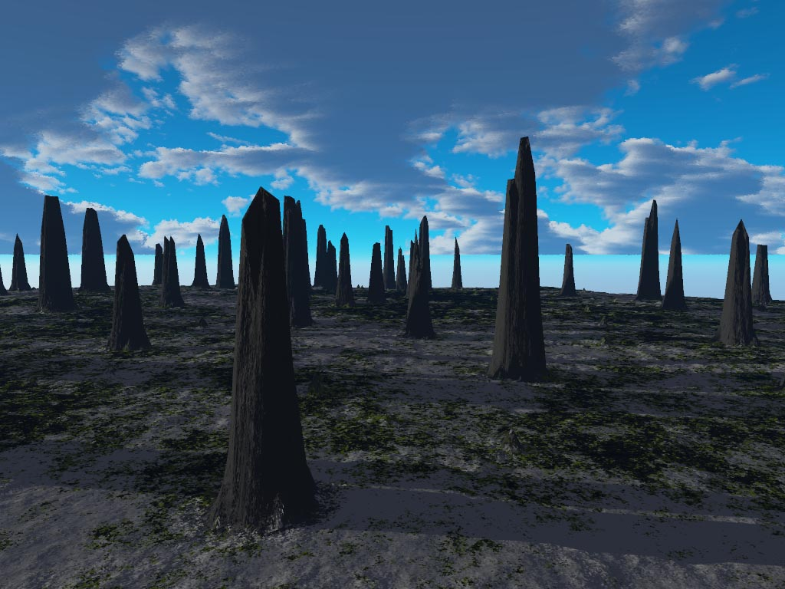
Will You Believe?
Doom and Destruction
is Decreed
Notes:
Doom and destruction is decreed against Israel for offenses against a Holy God. He has decreed destruction and dispersion for His people. The destruction will come by the LORD from Assyria who is merely a tool the hand of God to accomplish His purposes. But the LORD has also decreed destruction upon the destroyer, Assyria (Chapter 10) by the hands of the Babylonians. But don’t put your trust in them neither for God is the God of all the nations and will bring destruction of all the nations that have rebelled and ignored His ways (Chapter 13-35).
However, if you trust in Him, like my servant Hezekiah, then you will escaped destruction, at least temporarily. So listen, learn, and live.
But Hezekiah is not the anointed deliverer. There is yet One who will come “God with Us” who will bring in a kingdom characterizes by righteousness and justice, the Prince of peace.
There is hope. Hope shines out of darkness. The gloom and the doom is not final. The darkness and emptiness is not an end in itself but a means whereby God’s goodness can be manifested in the salvation of the land and the people.

Slide 4
Will You Believe?
Hope Despite Destruction
10:5 – 11:16
Notes:
Soon a shoot from the root of Jesse, and son of David will arise and bring a final deliverance against all of Israel’s enemies and the nations. Satan will gather all the nations of the world in an attempt to annihilate God’s people, the physical descendants of Israel, only to be crushed by the LORD’s mighty hand.

Slide 5
Will You Believe?
Restoration is Promised
10:28-34
Notes:
Restoration is promised (Ch. 10:28-34) The LORD will come and establish His glorious kingdom on His mountain, Mt. Zion. His name will be called Jesus and He will be great, and will be called the Son of the Highest; and the Lord God will give Him the throne of His father David. And He will reign over the house of Jacob forever, and of His kingdom there will be no end.“ (Luke 1:31-33) The nation will become a great forest once again.
At that time, He will regather all of the dispersed remnant of Israel to Him from the four corners of the earth. They will live in peace amongst themselves and the nations that surrounded them. All nations will also come the LORD to be instructed by Him. For no one will say, “Do you know the LORD?” For everyone will know the LORD.

Slide 6
The Rule of the Branch of Jesse
The Messiah’s Rule
will have:
A Humble Beginning
Notes:
In chapter 11 will see now the rule of the branch of Jesse, the character and characteristics of the Son of David, the anointed One, the promise Messiah, and the promise Messianic age to come.

Slide 7
The Rule of the Branch of Jesse
“There shall come forth a Rod from the stem of Jesse, and a Branch shall grow out of his roots.” (11:1)
Notes:
The house (decedents) of David will fall into decay and obscurity yet there will arise from this family, an illustrious descendant none other than Jesus of Nazareth. When Jesus was born the royal family had fallen in decay. Jesus parents were poor, living in a obscure place, unknown, all the glory of the family had departed, yet that glory was going to be restored to an even greater degree that ever before.
Even though David's family, Judah and all of Israel were going to be cut down, God's promise to David to establish a descendant of his on the throne forever, still stands.

Slide 8
The Rule of the Branch of Jesse
“In that day the Branch of the LORD shall be beautiful and glorious; And the fruit of the earth shall be excellent and appealing for those of Israel who have escaped.” (4:2)
Notes:
"So, in that day the branch of the Lord will become beauty and glory, the fruit of the land, exaltation, and honor, for the survivors/remnant of Israel" (4:2)
Even though David's family, Judah and all of Israel were going to be cut down, God's promise to David to establish a descendant of his on the throne forever, still stands.

Slide 9
The Rule of the Branch of Jesse
The Messiah’s Rule
will have:
An Empowerment by the Spirit of the LORD
Notes:
Verse 1 announced the Messiah's humble origin and birth. Isaiah proceeds to describe His extraordinary endowment, powers, and gifts. No doubt a reference to the Holy Spirit. The Spirit of Yahweh shall rest upon Him - a spirit producing wisdom, understanding, etc. - all characteristics trace to the Holy Spirit in Scripture (I Cor. 12:8-11).
The Messiah will be empowered with the gifts and qualifications for His ministerial rule. The Davidic kings had come to manifest a spirit which had little of God in it and unless the Messiah is truly gifted with the Spirit of God, His rule would be no different than theirs.

Slide 10
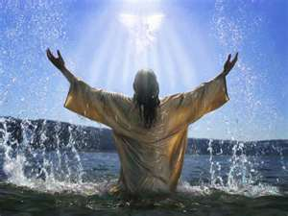
The Rule of the Branch of Jesse
“The Spirit of the LORD shall rest upon Him… (11:2a)
Notes:
The Spirit came and rested on Jesus:

Slide 11
The Rule of the Branch of Jesse
“When He had been baptized, Jesus came up immediately from the water; and behold, the heavens were opened to Him, and He saw the Spirit of God descending like a dove and alighting upon Him.” (Matt. 3:16)

Slide 12
The Rule of the Branch of Jesse
“And John bore witness, saying, "I saw the Spirit descending from heaven like a dove, and He remained upon Him… And I have seen and testified that this is the Son of God.” (John 1:32,34)

Slide 13
The Rule of the Branch of Jesse
“The Spirit of the Lord GOD is upon Me, because the LORD has anointed Me…” (61:1; Lk 4:18-19)
“mashach” – “mashiyach
“anointed” = “Messiah”
“anointed One” = “Christ”
Notes:
The anointing is also a fulfillment of Isaiah 61:1 which Jesus applied to Himself when he read in the synagogue in Nazareth from the assigned reading of that day which in God’s providence was from Isaiah 61:1-2. After reading the passage stopping short of “the day of vengeance of our God”.
“Then He closed the book, and gave it back to the attendant and sat down. And the eyes of all who were in the synagogue were fixed on Him. And He began to say to them, "Today this Scripture is fulfilled in your hearing." (Luke 4:20-22)

Slide 14
The Rule of the Branch of Jesse
“Andrew, Simon Peter's brother. He first found his own brother Simon, and said to him, ‘We have found the Messiah’ (which is translated, the Christ)”. (John 1:40b-42)
Notes:
Christ is the Greek translation of Messiah.

Slide 15
The Rule of the Branch of Jesse
“The woman said to Him, ‘I know that Messiah is coming" (who is called Christ). ‘When He comes, He will tell us all things.’ Jesus said to her, ‘I who speak to you am He.” (John 4:25-26)
Notes:
Jesus confess to the woman at the well that He was the Messiah.

Slide 16
The Rule of the Branch of Jesse
“…the Spirit of wisdom and understanding, the Spirit of counsel and might, the Spirit of knowledge and of the fear of the LORD.” (11:2b)
Notes:
The Holy Spirit came on He and empowered Him for ministry. Now remember that Jesus had humbled Himself and had given up the USE of His divine attributes (even though He still possessed them, otherwise He would cease to be God) Because He did not USE His divine attributes He was therefore totally dependent on the Spirit. All that He did was by the divine power of the Holy Spirit and not by His own divine power.

Slide 17
The Rule of the Branch of Jesse
The Spirit of the LORD will give Him:
“wisdom and understanding”
“…in whom are hidden all the treasures of wisdom and knowledge.” (Col. 2:3)
Notes:
The Spirit first gave Him wisdom and understanding -- which consists in the choice of the best means to secure the best ends. It’s knowing how to apply practically the knowledge one possesses.
Now Jesus relied on the Spirit for wisdom and knowledge even He possessed those attributes Himself.

Slide 18
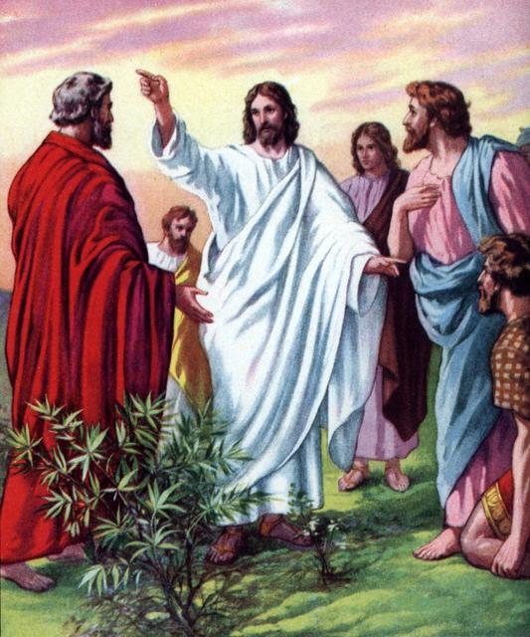
The Rule of the Branch of Jesse
The Spirit of the LORD will give Him:
“counsel and might”
Notes:
He will have a spirit of counsel and might -- He will be qualified to give counsel and advice as a public instructor or guide. He is the wonderful Counselor. Not only will he know what to do, and how to do it in the best way, but will also possess the power and boldness to carry it out. Unlike many leaders who know what to do, but because of fear fail to carry out what they know is right. Jesus was not to say and do what was necessary. Others proclaimed that no one spoke like He did.

Slide 19
The Rule of the Branch of Jesse
“Then they were all amazed and spoke among themselves, saying, ‘What a word this is! For with authority and power He commands the unclean spirits, and they come out.” (Luke 4:36)

Slide 20
The Rule of the Branch of Jesse
“The officers answered, ‘No man ever spoke like this Man!” (John 7:46)

Slide 21
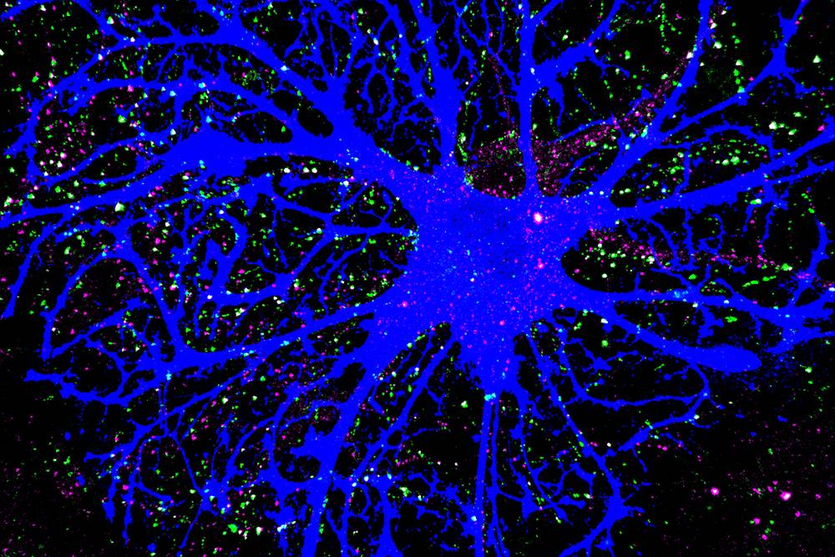
The Rule of the Branch of Jesse
The Spirit of the LORD will give Him:
“knowledge and
the fear of the LORD”
Notes:
He will have a spirit of knowledge and fear -- He will have a knowledge of the attributes of God like no other:
"All things have been handed over to Me by My Father; and no one knows the Son except the Father; nor does anyone know the Father except the Son, and anyone to whom the Son wills to reveal Him" (Matt 11:27). "No one has seen God at any time; the only begotten God who is in the bosom of the Father, He has explained Him" (John 1:18).
He will have a reverence for God and His commands. Jesus' desire had no other than to please His Father and do His will.

Slide 22
The Rule of the Branch of Jesse
“All things have been delivered to Me by My Father, and no one knows the Son except the Father. Nor does anyone know the Father except the Son, and the one to whom the Son wills to reveal Him.” (Matt. 11:27)

Slide 23
The Rule of the Branch of Jesse
“No one has seen God at any time. The only begotten Son, who is in the bosom of the Father, He has declared Him.” (John 1:18)

Slide 24
The Rule of the Branch of Jesse
The Messiah’s Rule
Theme Developed
“My Ideal Servant King”
Chapters 49-55
“The Ideal Kingdom”
Chapters 56-66
Notes:
Additional characteristics of the Messiah, the idea servant King is more fully developed in Isaiah 49-55.
Additional characteristic are more fully developed concerning the idea Kingdom in Isaiah 56-66.
The characteristics of the Servant King and His kingdom are introduced here in Chapter 11 and 7.

Slide 25
The Rule of the Branch of Jesse
The Messiah’s Rule
will be Characterized by:
Righteousness and Justice
Notes:
This paragraph moves from the endowment of the Messiah to a description of the manner in which he carries out his rule. He will not govern on the basis of appearances, but will operate out of a fundamental righteousness and faithfulness. His ministerial rule will be carried out with perfect correctness. Absolute justice requires absolute knowledge which the Messiah will possess. Based on the fact he will have all possible knowledge to make his decisions. He will know the hearts of men.

Slide 26
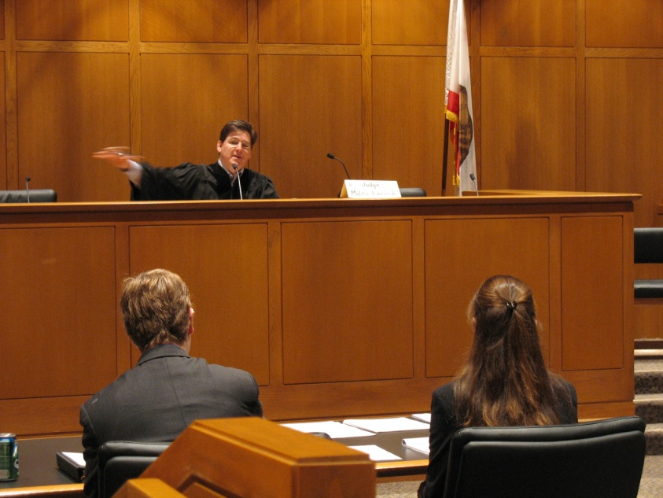
The Rule of the Branch of Jesse
“His delight is in the fear of the LORD, and He shall not judge by the sight of His eyes, nor decide by the hearing of His ears;” (11:3)
Notes:
In contrast to human leader who base their decision on impartial information – making judgements only by what they see and hear.
The coming Ruler will have an acute discrimination. Jesus exhibited knowledge that only God can possess:
But Jesus, on His part, was not entrusting Himself to them, for He knew all men, and because He did not need anyone to testify concerning man, for He Himself knew what was in man. John 2:24-25
For Jesus knew from the beginning who they were who did not believe, and who it was that would betray Him. John 6:64
This king will go deeper and will pierce beneath appearances to the underlying reality and be able to discern the true merits of every case and situation.

Slide 27
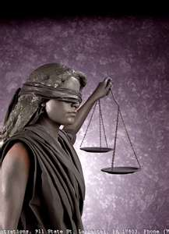
The Rule of the Branch of Jesse
“But with righteousness He shall judge the poor, and decide with equity for the meek of the earth; (11:4a)
Notes:
The poor who are generally left out and do not receive the due process of the law will be judge with fairness.

Slide 28
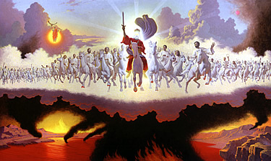
The Rule of the Branch of Jesse
“He shall strike the earth with the rod of His mouth, and with the breath of His lips He shall slay the wicked.” (11:4b)
Notes:
"He will strike the earth with the rod of his mouth" -- Because He owns no allegiance to any earthly pressure groups, he can say and do what needs to be said and done in any given circumstance. His word alone is his weapon. His word is a rod (different from vs.1) of chastisement or correction. It is against those who dwell on the earth which is synonymous with the wicked. He will bring judgment upon the wicked with just a word. When the Messiah is revealed from heaven He is described as having coming out of his mouth a sharp two-edged sword (Rev. 1:16) and with this sword he will strike the nations

Slide 29
The Rule of the Branch of Jesse
“Now out of His mouth goes a sharp sword, that with it He should strike the nations. And He Himself will rule them with a rod of iron. He Himself treads the winepress of the fierceness and wrath of Almighty God.” (Rev. 19:15) – “the day of vengeance of our God” (Isa 61:2b)

Slide 30
The Rule of the Branch of Jesse
“I will declare the decree: The LORD has said to Me, ‘You are My Son, today I have begotten You. Ask of Me, and I will give You the nations for Your inheritance, and the ends of the earth for Your possession. You shall break them with a rod of iron; You shall dash them to pieces like a potter's vessel.” (Ps. 2:7-9)

Slide 31
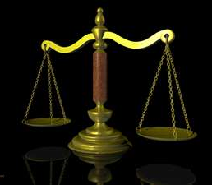
The Rule of the Branch of Jesse
“Righteousness shall be the belt of His loins, and faithfulness the belt of His waist.” (11:5)
Notes:
His word will be just, impartial, and authoritative. The Messiah will bring justice and equality upon the earth because fundamental to his own character will be two essential qualities: righteousness and faithfulness. Righteousness is that capacity for always doing the right thing in all circumstances. Faithfulness means to be dependable and true. His judgments and rule will always be right and consistent which results in complete dependability. These characteristics of righteousness and faithfulness is the belt which brings all the Messiah's other attributes together and are the qualities most basic and fundamental to all the others.

Slide 32
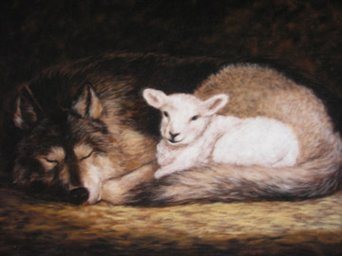
The Rule of the Branch of Jesse
The Messiah’s Rule
will be Characterized by:
Peace and Security
Notes:
This classic set of images is a description of the kind of security and safety which will characterize the Messiah's rule. The most helpless and innocent will be at ease with those who were formerly the most violent. The overarching point is that in the Messiah's reign the fear generally associated with insecurity, danger, and evil will be removed. The change will be so radical that it will not only cause a change in the heart of man, but will extend to the animal kingdom as well. The Messiah affect over the world will be cosmic, including the whole universe.

Slide 33
The Rule of the Branch of Jesse
“The wolf also shall dwell with the lamb, the leopard shall lie down with the young goat, the calf and the young lion and the fatling together; And a little child shall lead them.” (11:6)

Slide 34
The Rule of the Branch of Jesse
“The cow and the bear shall graze; Their young ones shall lie down together; And the lion shall eat straw like the ox. The nursing child shall play by the cobra's hole, and the weaned child shall put his hand in the viper's den.” (11:7-8)

Slide 35
The Rule of the Branch of Jesse
“They shall not hurt nor destroy in all My holy mountain, for the earth shall be full of the knowledge of the LORD as the waters cover the sea.” (11:9)
Notes:
In the Messiah's day will He comes in glory death itself will be conquered extending even to the animal kingdom and the principle of death will be erased. The animals will be so tamed that a small child will lead them. The animals will come under the subjection of man, just as God had originally designed.
“The earth will be full of the knowledge of God" -- even the animals will know God's ways and they shall be disposed to yield to his will producing universal peace and security.

Slide 36
The Rule of the Branch of Jesse
Three Ways of Interpretation
Literally
Spiritually
Figuratively

Slide 37
The Rule of the Branch of Jesse
Literally
A literal fulfillment of the prophecy would require a basic alteration of the nature of a wolf, a bear and the lion.
Notes:
Looking for the literal fulfillment of the words. A literal fulfillment of the prophecy would require a basic alteration of the nature of a wolf, a bear and the lion. Is this possible? That certainly not the case now. The current state of the affairs is this

Slide 38
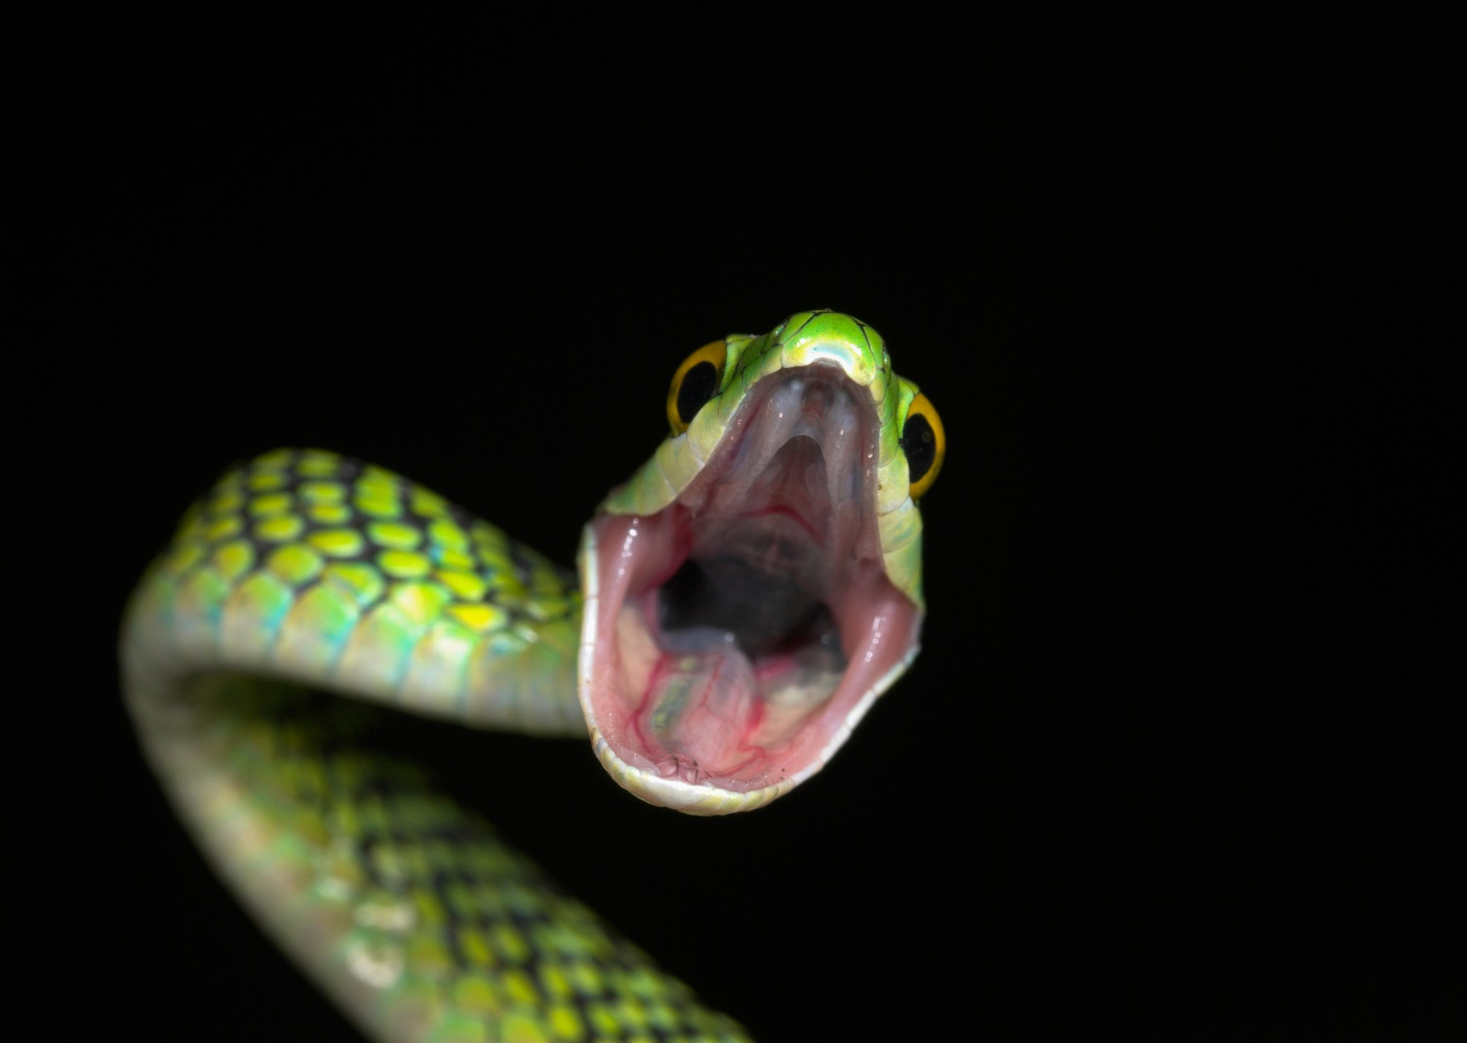
The Rule of the Branch of Jesse
Notes:
Man lives in fear of the animals, especially deadly ones and he lives in fear of nature. Because some people do not believe that the nature of animals cannot be changed they believe that this passage cannot be interpreted literally or historically, but ought to be interpreted allegorically.
Was there ever the case in the past when the nature of animal were different than in the present? Biblically, Yes!

Slide 39
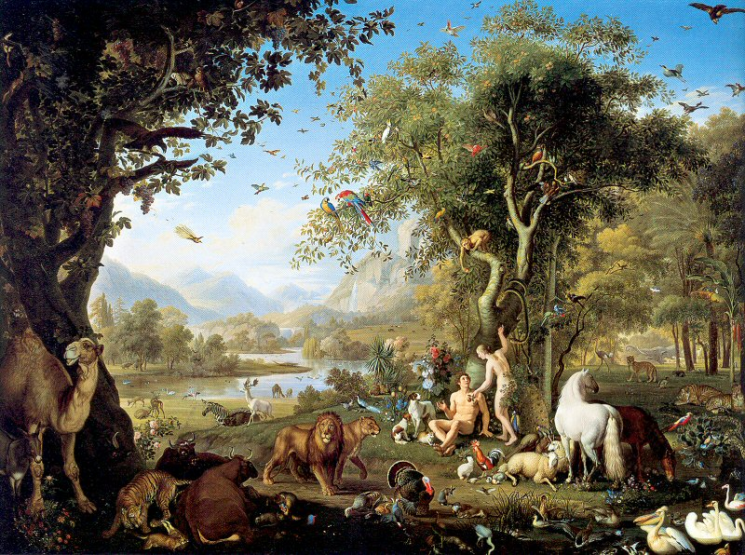
The Rule of the Branch of Jesse
Literally
Notes:
This is the impression we get from the garden of Eden, in Paradise, in which all creatures lived in peace and harmony. God brought the animals before Adam to be name by Him, not to be eaten or harmed by them.

Slide 40
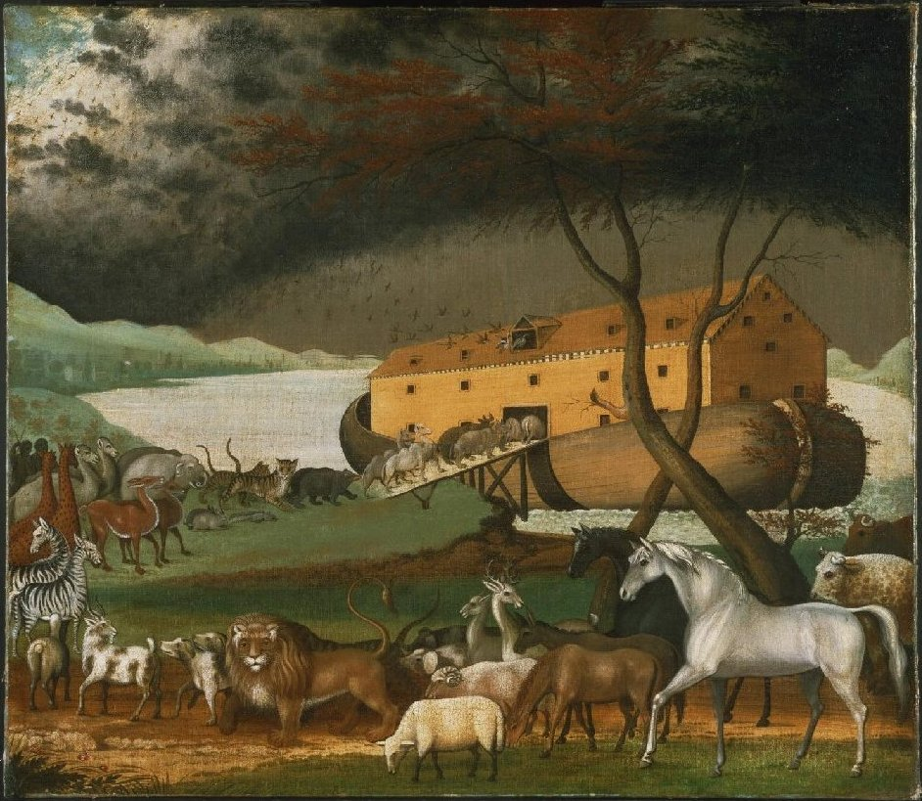
The Rule of the Branch of Jesse
Literally
Notes:
This is the impression we get when God brought the animals to Noah in the ark.
Can the natural of an animal change? No, may say,

Slide 41
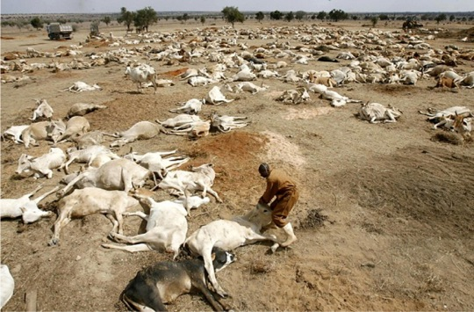
The Rule of the Branch of Jesse
Death
Notes:
The death of animals in natural, the way its always been, the way it is, the way it always will be. It was the ways things were for millions of years before man evolved on the earth. Its part of the survival of the fittest. And man is simply an advanced animal. So death will never cease.
Wars, famines, pestilence, disease, oppression, death are all natural and good.
Isaiah though gives us a vision of hope that things will change, that does not include the fear of death by wars, animal attacks and natural disasters. A vision of a coming world that people can live in peace with one another and with nature itself.

Slide 42
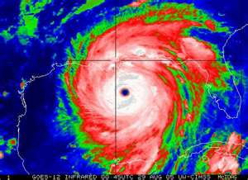
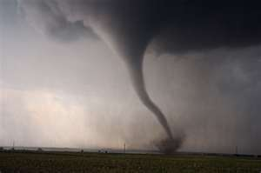
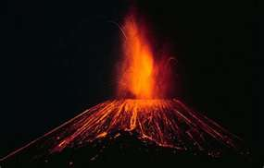
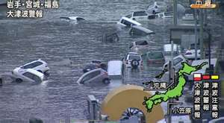
The Rule of the Branch of Jesse
“For the creation was subjected to futility, not willingly… because the creation itself also will be delivered from the bondage of corruption into the glorious liberty of the children of God. For we know that the whole creation groans and labors with birth pangs together until now.” (Rom. 8:20-21)
Notes:
Nature looks in its own way to be liberated from the bondage of corruption and calamity for God children.

Slide 43
The Rule of the Branch of Jesse
“The earth is also defiled under its inhabitants, because they have transgressed the laws, changed the ordinance, broken the everlasting covenant. Therefore the curse has devoured the earth, and those who dwell in it are desolate. (Isa. 24:5-6)
Notes:
Adam’s sin not only affected him it also affected the environment in which he existed. Adam’s environment was cursed because of his sin. He lost control and rule over the earth. His sin brought decay into the entire universe.
Christ death was not only for the purpose of redeeming mankind, but it had even a greater effect. His death was not only for the elect, but for all men. His death had and will have even a cosmic effect and change, which will bring all things in subjection to Him.

Slide 44
The Rule of the Branch of Jesse
“For He must reign till He has put all enemies under His feet. The last enemy that will be destroyed is death. For "He has put all things under His feet…” (1 Cor. 15:25-27)

Slide 45
The Rule of the Branch of Jesse
Literally
Notes:
If Christ can change the nature of man’s heart it is even less of a task for God to change the nature of the animals. Will He not do this? Change the nature of the animals? Christ can not only make an effectual change in the heart of men, but will make an effectual cosmic change in the nature and structure of the universe; to return the heaven and the earth to its original perfect state before the fall, where there was no death, no ferocious lions eating other animals as well. After God had completed his creative work He concluded that what He had made was very good! (Gen. 1:31). By the act of unrighteousness of Adam brought death into the world, so the one act of righteousness by Christ brought the abolishment of death.

Slide 46
The Rule of the Branch of Jesse
Spiritually
The animals represent various spiritual conditions and states within human beings.
“as if”
Notes:
Many commentaries suggest that this passage should be interpreted only in a "moral sense" - giving only a description of a change in the human heart. It is an "as if" statement. It is not a description of a true reality of something that will actually occur in the future. It is not a reference to any literal change in the nature of animals. If this was a literal change then the wolf or the lion would cease to be defined as a lion, because in order for a lion to be a lion it must be ferocious, or it’s not a lion, as they define a lion. Barnes states that,
“A fair interpretation is that revolutions will be produced in the wild and evil passions on men (the only thing the gospel has to do), as great “as if” a change were produced in the animal creation and the most ferocious and the most helpless should dwell together”.
They interpret this passage as an allegory.

Slide 47
The Rule of the Branch of Jesse
“Allegory” – “Writers… use allegories as literary devices or as rhetorical devise that convey hidden or complex meaning through symbolic figures, actions, imagery, or events, which together create the moral, spiritual, or political meaning the author wishes to convey.” (Google)
Notes:
Many say that this should interpreted spiritually because this passage and others like it, are allegorical. An allegory is a prolong metaphor, a rhetorical device given it a sense higher than the literal. The allegory was develop in Greece around the sixth century BC.

Slide 48
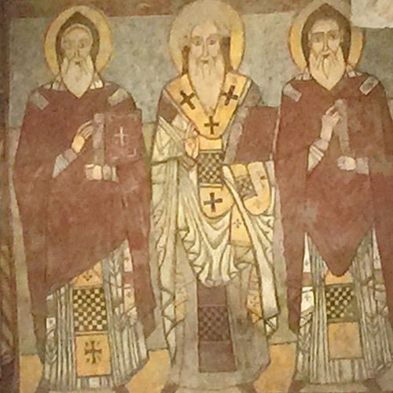
The Rule of the Branch of Jesse
Allegory
The Alexandria School of theology introduced the allegorical interpretation to the church.
Clement and Origen
Notes:
The Alexandria School of theology introduced the allegorical interpretation to the church. Clement of Alexandria, became the head of the school there in 190 AD. A philosopher throughout his life, saw Greek philosophy as a preparation for Christ. Along with Origen (231) they believed that all Scripture should be interpreted allegorically. Origin valued the mystical meaning more than the literal.

Slide 49
The Rule of the Branch of Jesse
Allegory
“The allegory was employed by the school in order to remove the crude literalism which offended the Greek mind”
(Bakers Dictionary of Theology)
Notes:
According to Eerdmans Handbook of the History of Christian, “their crucial achievement of Clement and Origin was to put the gospel in terms which could be understood by the people familiar with the highest forms of Greek culture.” (p. 79) They were also responsible for laying the theological foundation for asceticism.

Slide 50
The Rule of the Branch of Jesse
Allegory
“Origin repudiated the literal interpretation of those who believed in a coming millennium as “Jewish”
(Revelation, Four Views)
Notes:
The premillennial view was the held by the church prior to the Alexandrian School.

Slide 51
The Rule of the Branch of Jesse
Allegory
The church rejected the allegorical interpretation of all Scripture, but Augustine retained the allegorical method of interpretation
for all unfulfilled prophecy.
Notes:
The church rejected the allegorical interpretation of all Scripture, declaring it heretical, but Augustine (who lived in the 5th century) retained the allegorical method of interpretation for all unfulfilled prophecy. Jerome is chiefly responsible for introducing allegory into the Roman church. This became the standard for the church until the Reformation, a 1000 years later.

Slide 52
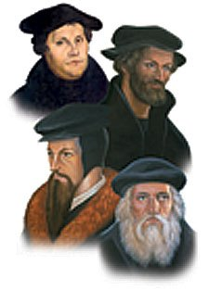
The Rule of the Branch of Jesse
Allegory
Luther, Melanchthon, and Calvin rejected the allegory because it was too subjective and
uncontrollable.
Notes:
Luther, Melanchthon, and Calvin rejected the allegory because it was too subjective and uncontrollable. They began to develop a historical view of prophecy in which promises of judgment and restoration is fulfilled throughout church history.
“Today many adopted a combination of the Preterist view (past) or the Historical view (present) which gives the interpreter a great deal of freedom but leaves his results mostly subjective.” (Walrvoord, The Revelation of Jesus Christ), p. 21)

Slide 53
The Rule of the Branch of Jesse
The Messiah’s Rule
will be Characterized by:
Peace and Security
Notes:
True peace and security can be historically and literally possible. For all things are possible with God. The futurist approach recognizes that there are figure of speech, metaphors, and symbolism in various prophecies, (a list of 39 different literary devices used in Scripture) but there is no good reason to use two different methods of interpretations, one for non-prophetic passages and one for all unfulfilled prophecies, one objective and one subjective.

Slide 54
The Rule of the Branch of Jesse
The Messiah’s Rule will:
Attract Gentiles

Slide 55
The Rule of the Branch of Jesse
“And in that day there shall be a Root of Jesse, Who shall stand as a banner to the people; For the Gentiles shall seek Him, and His resting place shall be glorious.” (11:10)
Notes:
Many say that this refers to the Gentiles coming to Christ in the church. However, the church is nonexistent in the Old Testament. The church is “the ecclesia” a group of “called out ones” from the nations and the nation of Israel into one body or assembly of believers. The church is never called a nation, ruled by a king. There is no reference to Jesus as being the king of the church.
Some say the “resting place” is a reference to the gospel church, the new Mt. Zion. However, Psalm 132 13-14 says,

Slide 56
The Rule of the Branch of Jesse
Paul says, “…I preach among the Gentiles the unsearchable riches of Christ, and to make all see what is the fellowship of the mystery, which from the beginning of the ages has been hidden in God who created all things through Jesus Christ;” (Eph. 3:8-9)
Notes:
God hid in Himself, not in His Word, not in the Old Testament, the mystery which we call the church.

Slide 57
The Rule of the Branch of Jesse
“you have heard of the dispensation of the grace of God which was given to me for you, how that by revelation He made known to me the mystery… which in other ages was not made known to the sons of men, as it has now been revealed by the Spirit to His holy apostles and prophets: that the Gentiles should be fellow heirs, of the same body, and partakers of His promise in Christ through the gospel.” (Eph. 4:3-6)
Notes:
What is unique and different is unity of Gentiles and Jews together as equals in one body.
“I became a minister according to the stewardship from God which was given to me for you, to fulfill the word of God, the mystery which has been hidden from ages and from generations, but now has been revealed to His saints. To them God willed to make known what are the riches of the glory of this mystery among the Gentiles: which is Christ in you, the hope of glory.” (Col 1:25-28)

Slide 58
The Rule of the Branch of Jesse
“And in that day there shall be a Root of Jesse, Who shall stand as a banner to the people; For the Gentiles shall seek Him, and His resting place shall be glorious.” (11:10)
Notes:
In the messianic age Israel will be a nation living with peace and harmony with the nations of the earth. There will be no one big nation.
Some say the “resting place” is a reference to the gospel church, the new Mt. Zion. However, Psalm 132 13-14 says,

Slide 59
The Rule of the Branch of Jesse
“For the LORD has chosen Zion; He has desired it for His dwelling place: ‘This is My resting place forever; Here I will dwell, for I have desired it.” (Psalm 132:13-14)

Slide 60
The Rule of the Branch of Jesse
The Messiah’s Rule will:
Regather the Scattered Remnant of Israel

Slide 61
The Rule of the Branch of Jesse
“It shall come to pass in that day that the Lord shall set His hand again the second time to recover the remnant of His people who are left, from Assyria and Egypt, from Pathros and Cush, from Elam and Shinar, from Hamath and the islands of the sea.” (11:11)
Notes:
The first time was when God lead them out of Egypt. The second time will be even greater because the God will lead them to the promise land not just from one nation, but from many nations all over the earth, from every corner of the earth.
Though it was significant evert, the second time was not the remnant that returned from Babylon. That return was from only one nation and only a small remnant returned while the majority stayed behind. This recover will bring every physical child of Abraham back to the land.
The establishment of the nation of Israel in 1948 and the large number of Jews that have returned to Israel since that time is also significant. But I believe even today there are still more Jews living outside of the land of Israel than live within its borders.

Slide 62
The Rule of the Branch of Jesse
“He will set up a banner for the nations, and will assemble the outcasts of Israel, and gather together the dispersed of Judah from the four corners of the earth.” (11:12)

Slide 63
The Rule of the Branch of Jesse
The Messiah’s Rule will:
Heal the Strife between Ephraim and Judah
Notes:
The internal strife between the tribes of Israel will be heal and will live in peace amongst each other.

Slide 64
The Rule of the Branch of Jesse
“Also the envy of Ephraim shall depart, and the adversaries of Judah shall be cut off; Ephraim shall not envy Judah, and Judah shall not harass Ephraim.” (11:13)

Slide 65
The Rule of the Branch of Jesse
The Messiah’s Rule will:
Deliver Israel from their Enemies

Slide 66
The Rule of the Branch of Jesse
“But they shall fly down upon the shoulder of the Philistines toward the west; Together they shall plunder the people of the East; They shall lay their hand on Edom and Moab; And the people of Ammon shall obey them.” (11:14)
Notes:
There will only be peace when Israel’s enemies are defeated, and made subject to them, under the authority of the anointed One.

Slide 67
The Rule of the Branch of Jesse
The Messiah’s Rule will:
Transform the Landscape

Slide 68
The Rule of the Branch of Jesse
“The LORD will utterly destroy the tongue of the Sea of Egypt; With His mighty wind He will shake His fist over the River, and strike it in the seven streams, and make men cross over dryshod.” (11:15)
Notes:
God will literally, historically will remove all physical barriers that would hinderer the remnant of Israel from returning to their Land. The events surrounding their return will be a greater miracle than it was when they left Egypt the first time. The LORD will dry up this time two rivers, not just one.
The transformation of the land and the earth is given more development in chapters 56-66.

Slide 69
The Rule of the Branch of Jesse
The Messiah’s Rule will:
Create an Expressway

Slide 70
The Rule of the Branch of Jesse
“There will be a highway for the remnant of His people who will be left from Assyria, as it was for Israel in the day that he came up from the land of Egypt.” (11:16)
Notes:
The expressway with no traffic jams will run from Assyria through the Land of Israel all the way to Egypt.
“as it was for Israel in the day that he came up from the land of Egypt” – was that an historic literal event? I rest my case!

Slide 71
Will You Believe?
Doom

Slide 72
Will You Believe?
Bloom

Slide 73
The Vision of Isaiah

